Slide 1


Capstone Project - Sales Analytics

Slide 2


PUBLICATIONS
Customers Analysis
Orders Analysis
Employees Analysis
Products & Suppliers
Insights

Slide 3
Objective:
The objective of this project is to build an interactive Power BI dashboard based on the Northwind sales dataset. The dashboard aims to provide meaningful insights about customer behavior, order trends, employee structure, and supplier contributions to improve decision-making in business operations.
Analysis Scope:
Customers Analysis: Evaluates customer distribution across regions, contact titles, and order frequency.
Orders Analysis: Tracks changes in order volume and shipping duration, and visualizes order value distribution.
Employees Analysis: Examines the regional and hierarchical structure of employees, and their tenure distribution.
Products & Suppliers: Assesses product performance, pricing trends, supplier reach, and geographic distribution.

Slide 4
GOAL:
The goal of the dashboard is to equip stakeholders with a comprehensive, data-driven view of the company’s sales and operations. It supports data-backed decisions on improving marketing, streamlining supply chains, and enhancing customer engagement.

Slide 5
ER DIAGRAM

Slide 6

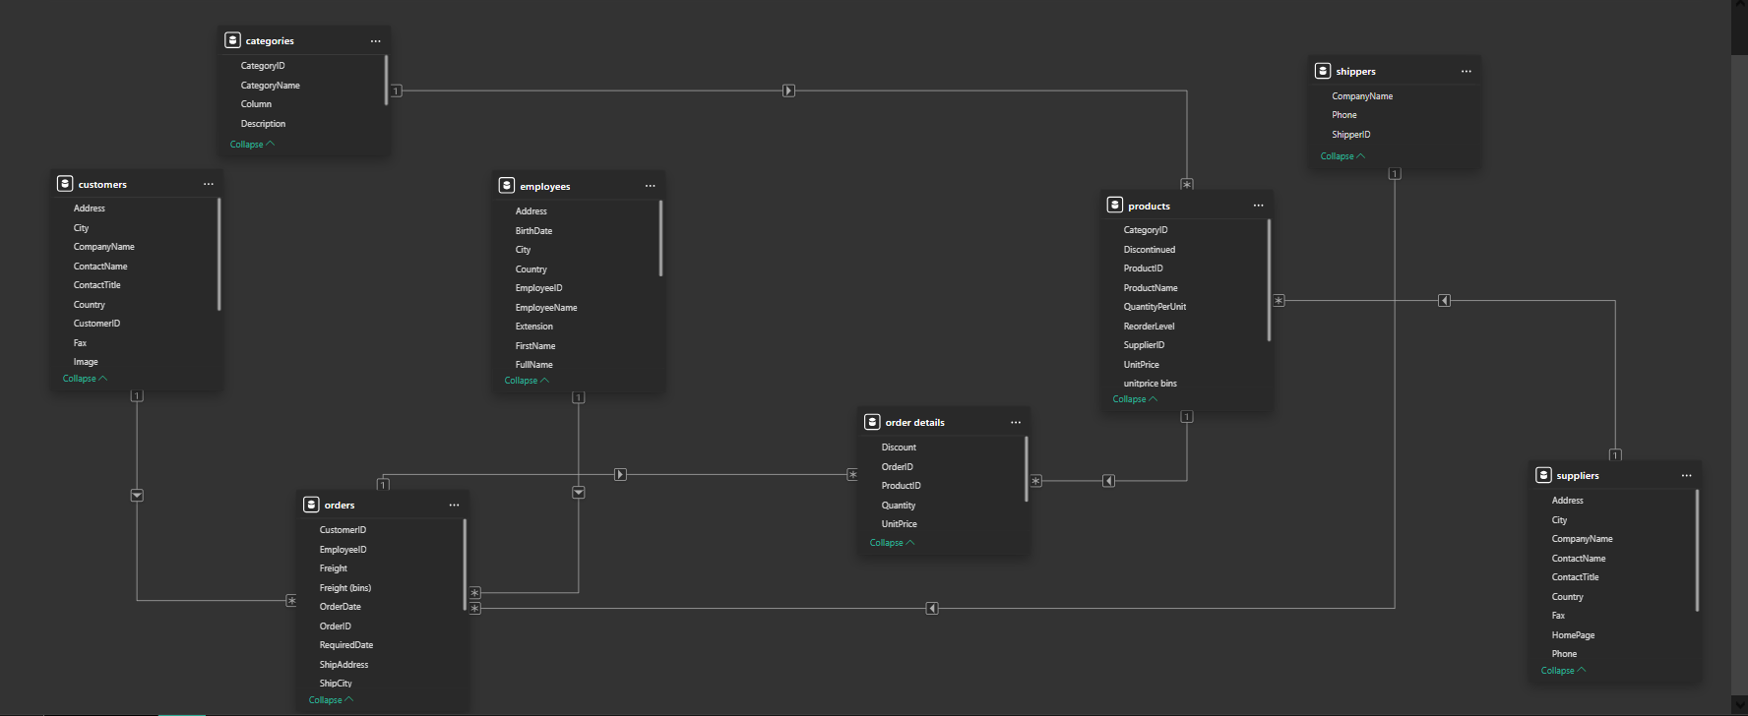

Slide 7
Power BI Problem Statements

Slide 8
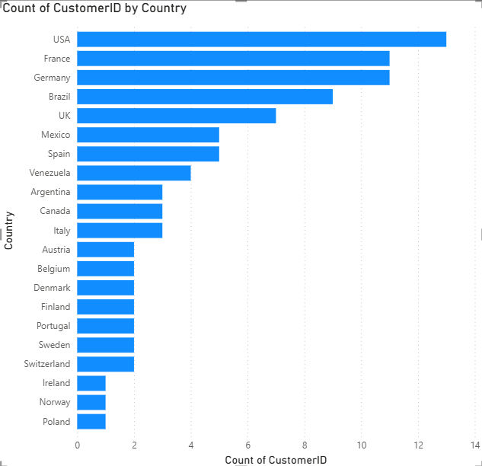
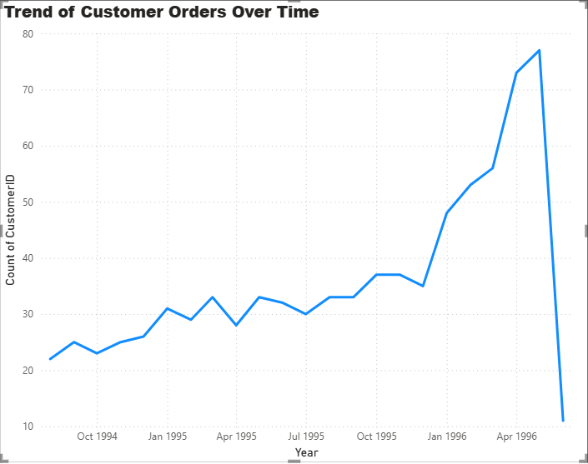
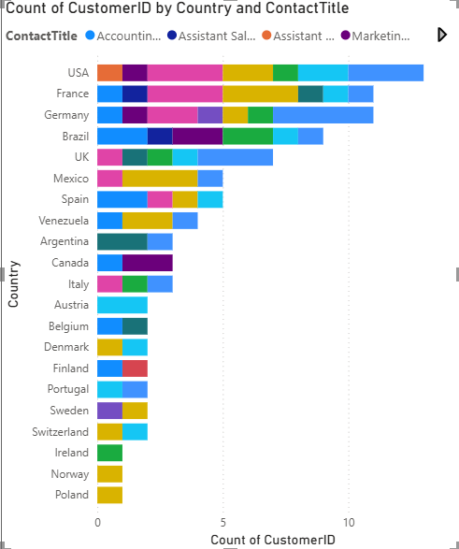
Customers Analysis

Slide 9
How does customer distribution vary across different countries or cities?
The customer base is concentrated in a few key countries, with the highest number of customers located in the USA, followed by Germany and the UK. This indicates a strong presence in Western markets. Cities like Berlin, London, and New York emerged as primary hubs. The distribution highlights regions where customer engagement and marketing strategies are currently effective and where there is potential for geographic expansion.

Slide 10
What is the trend in customer orders over time?
The order volume shows a consistent upward trend over time, indicating growing customer activity and engagement. Certain months/seasons reflect spikes, likely tied to promotional periods or seasonal demand. Identifying these peak months can help in planning targeted campaigns and inventory management. Overall, the trend reflects a positive trajectory in customer retention and acquisition.

Slide 11
What is the distribution of customers by Contact Title or Region?
Most customers hold titles such as "Owner," "Sales Representative," and "Marketing Manager." These roles are typically decision-makers in purchasing, highlighting the importance of relationship management with key contacts. Regionally, North America and Europe dominate the customer base. This segmentation can be used to tailor communication and sales approaches based on job function and location.

Slide 12
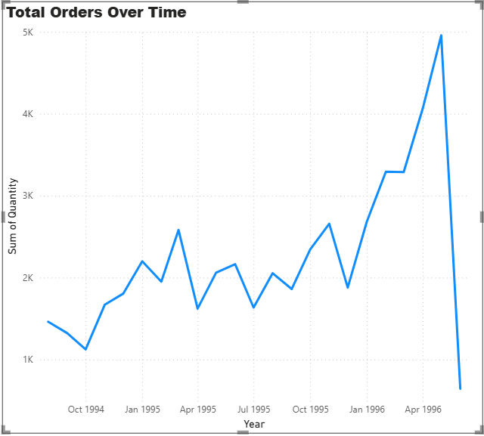
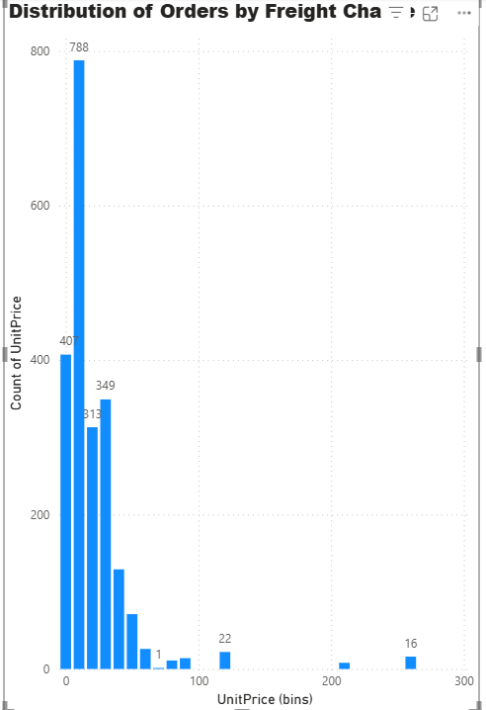
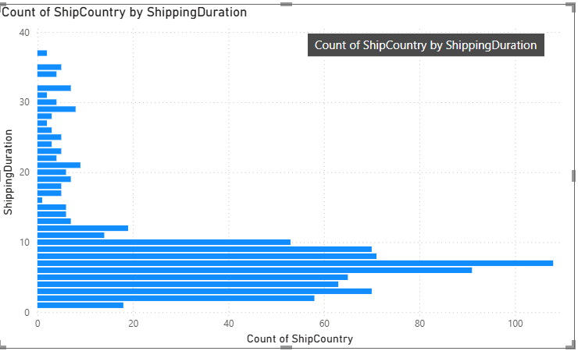
Orders Analysis

Slide 13
How does order volume change over time?
The order volume over time reveals a clear pattern of monthly or seasonal fluctuations. Certain months show higher order activity, possibly aligning with promotional campaigns or festive seasons. A gradual increase in total orders indicates healthy business growth. Analyzing these trends helps in forecasting demand and aligning supply chain and inventory accordingly.

Slide 14
What is the distribution of order values?
The distribution of order values is positively skewed, with most orders falling within a mid-range bracket. However, a few high-value orders create outliers, as shown in the box plot. This suggests that while average order value remains consistent, large-volume clients occasionally drive spikes. This insight helps in identifying high-value customers and optimizing order management strategies.

Slide 15
What is the average order shipping duration?
The average shipping duration varies slightly across different orders, with most shipments delivered within a 3–5day range. A few longer durations highlight delays, possibly due to logistics or regional factors. The box plot identifies these exceptions, helping businesses pinpoint inefficiencies and improve delivery reliability and customer satisfaction.

Slide 16
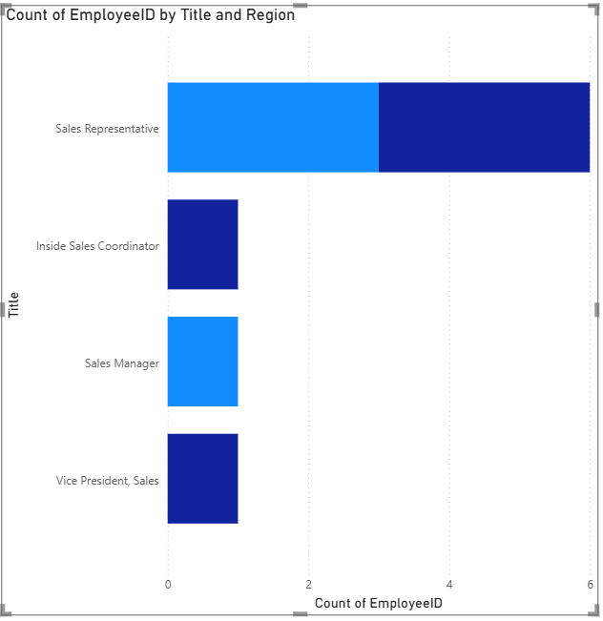
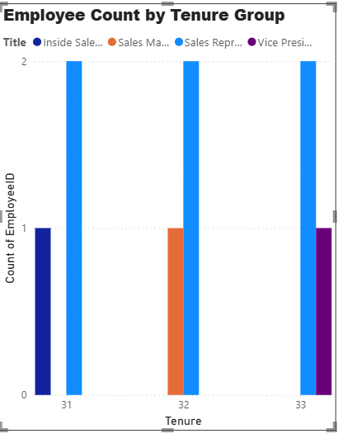
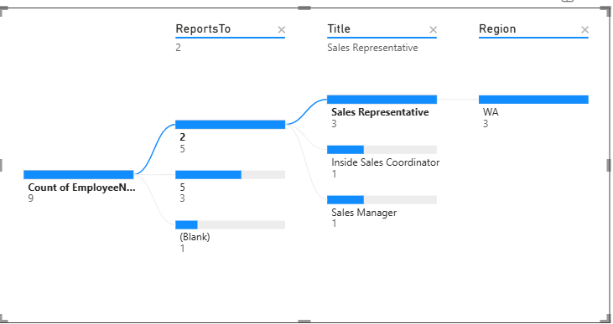
Employees Analysis

Slide 17
What is the count of employees by job title or region?
The majority of employees fall under roles like "Sales Representative," "Vice President, Sales," and "Inside Sales Coordinator." Region-wise, the company has a strong workforce presence in the U.S. and parts of Europe. This distribution reflects how teams are structured to support customer outreach and business development across key regions. It also highlights where the company might need to hire or redistribute personnel

Slide 18
What is the distribution of employee tenure?
The tenure distribution shows that most employees have between 3 to 6 years of experience with the company. A few senior employees have longer tenures, while newer hires form a smaller segment. This indicates a healthy mix of experience and fresh talent. Analyzing tenure helps in understanding employee retention trends and planning succession or training programs.

Slide 19
What is the reporting structure among employees?
The org chart clearly outlines a top-down structure, with the Vice President of Sales at the top, followed by Sales Managers and Sales Representatives. This hierarchy helps visualize the reporting relationships and team structure. Understanding the organizational layout can assist in streamlining communication, managing workloads, and planning for growth.

Slide 20
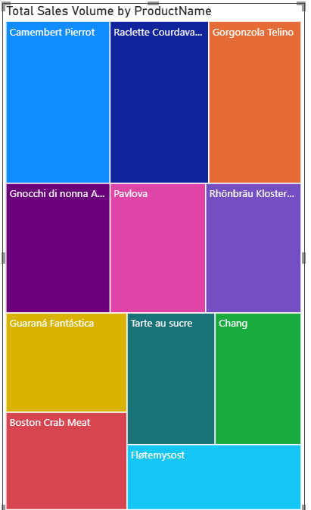
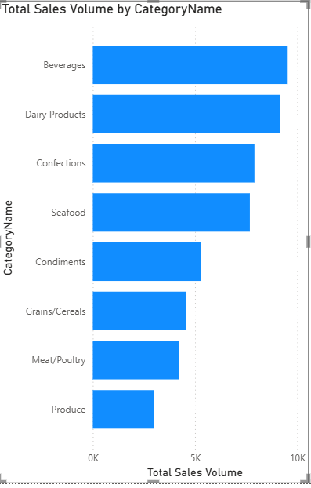
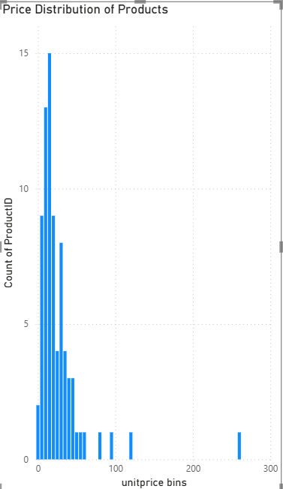
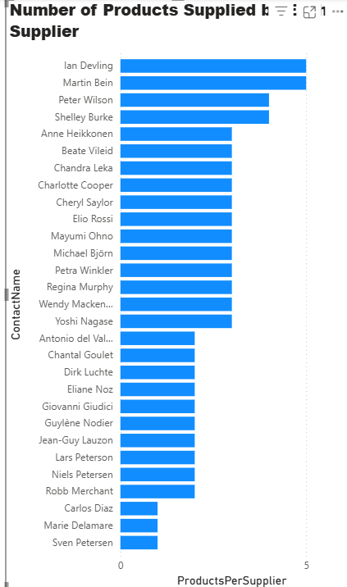
Products & Suppliers

Slide 21
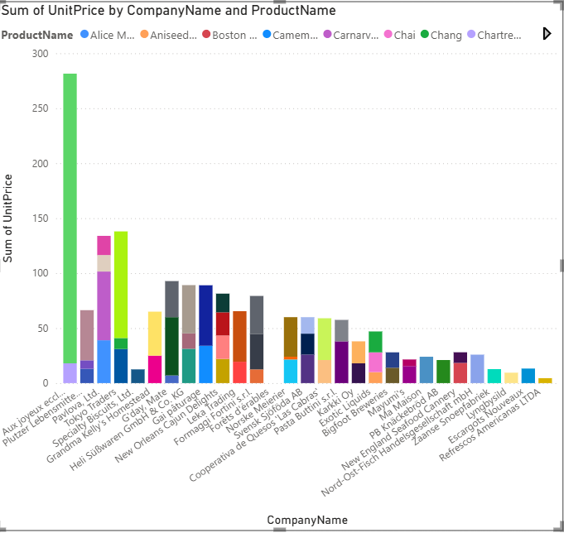
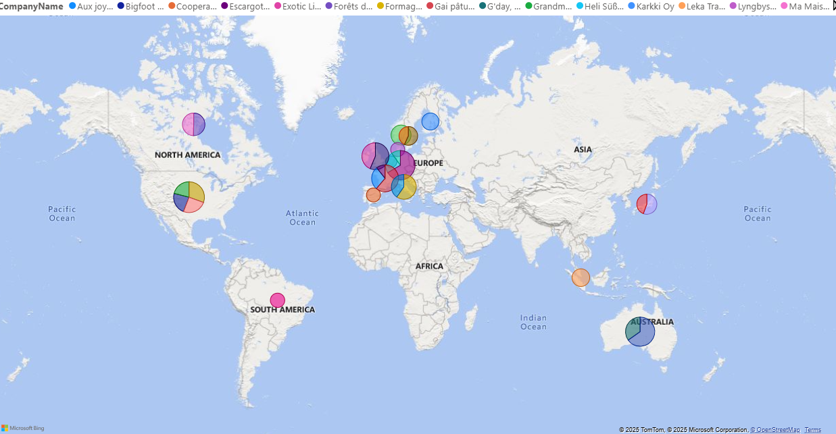

Slide 22
Which products have the highest sales volume?
A few products, such as [insert top product name(s)], contribute significantly to the total sales volume. These high-performing items are consistently in demand across regions. Identifying these top products allows the business to focus marketing, inventory, and supply chain efforts on items that yield the highest returns.

Slide 23
How does the sales volume vary across different product categories?
Product categories like [e.g., Beverages, Condiments] dominate the overall sales volume. Some categories consistently outperform others across different markets. This variation suggests that the company should align its sales strategy and stock management according to category performance and customer preferences

Slide 24
Can we visualize the pricing distribution of products?
The pricing distribution is skewed, with most products priced within a mid-range bracket. A few premium-priced products form the upper outliers. The chart highlights the range, median, and skewness, helping identify pricing inconsistencies and opportunities for bundling or pricing optimization.

Slide 25
How many products are supplied by each supplier?
A small number of suppliers provide a large share of the product range. For example, [insert top supplier name] supplies the highest number of products. This indicates a dependency on key suppliers, and it also identifies opportunities to diversify supply sources or renegotiate terms with high-volume suppliers.

Slide 26
How does product pricing vary across different suppliers?
Pricing patterns differ significantly among suppliers. Some consistently offer lower-cost products, while others focus on premium pricing. The box plot reveals pricing dispersion and helps identify which suppliers offer cost-effective products or premium goods. This analysis can inform future procurement and supplier negotiation strategies.

Slide 27
What is the geographical distribution of suppliers?
Suppliers are geographically spread, with key clusters in regions like [insert dominant countries/cities]. This distribution provides insights into the company’s global sourcing network. Understanding this spread is essential for logistics planning, cost management, and evaluating risk factors related to regional disruptions.

Slide 28
Insights & Recommendations:
The majority of customers are concentrated in specific cities/countries.
Sales are dominated by a few high-performing products and categories.
Employee reporting is clearly structured but some regions have low tenure.
Order shipping durations vary by region, indicating logistics optimization opportunities.
Supplier diversity is limited, and pricing is uneven across suppliers.

